Slide 1
INFO 250 Information Visualization
Week 1: Introduction and Overview

Slide 2
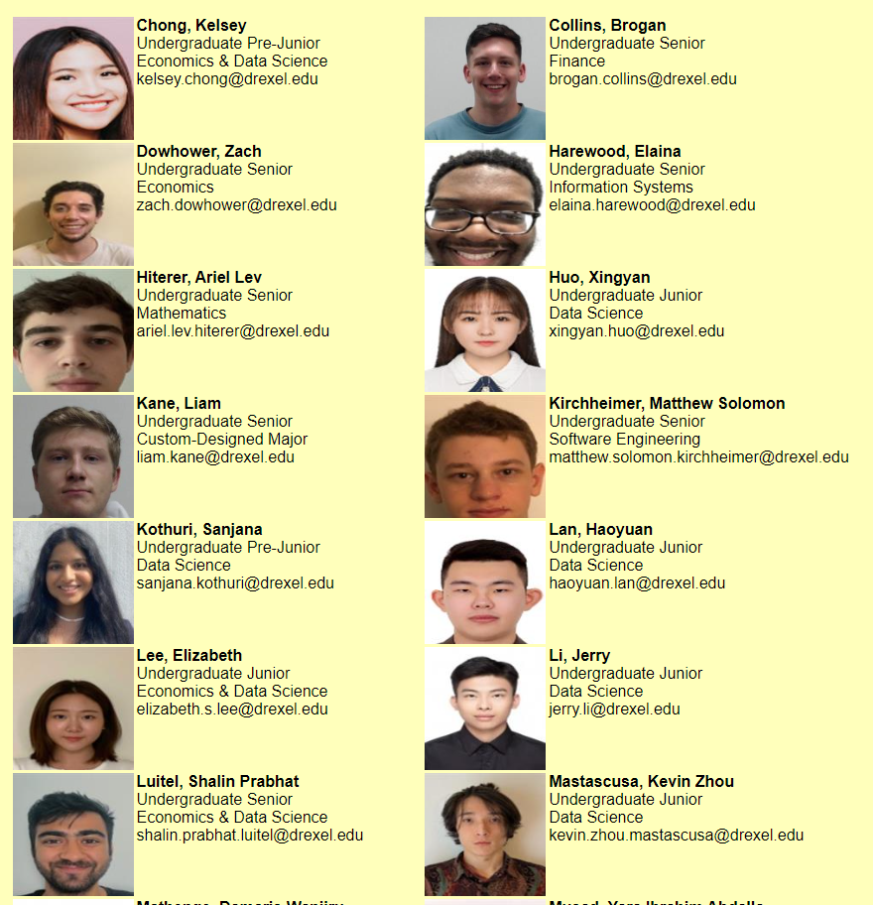

Slide 3
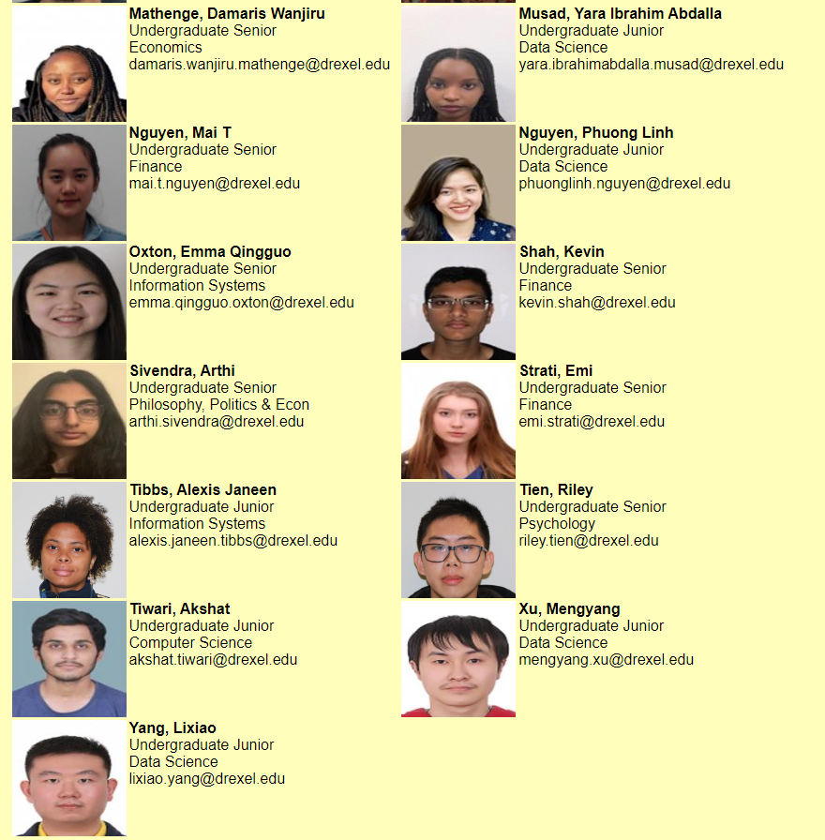

Slide 4
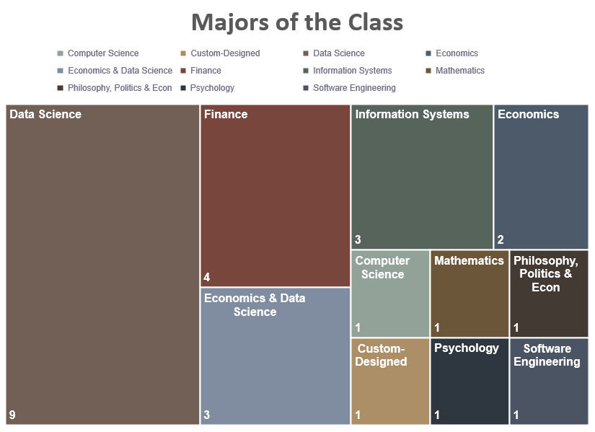

Slide 5
Course Description
Introduces the foundation and the state of the art of information visualization. Explores and reflects on the design, application, and evaluation of a variety of common data and graph types. Exposure to some basic visualization tools. Credits: 3.0 Repeat Status: Not repeatable for credit College/Department: College of Computing and Informatics Pre-requisite: None This course will have not required textbook.

Slide 6
Contact Information
Instructor | Chaomei Chen
Contact Information | cc345@drexel.edu
Office | 1125 @ 3675 Market Street
Office Hour | By appointment
Course Assistant | Hajun Lee
Contact Information | hl633@drexel.edu
Office | Online
Office Hour | TBA

Slide 7
Course Outcome
Upon successful completion of this course, you will be able to:
Explain fundamental principles of information visualization
Explain key stages of an information visualization process
Characterize visual representations of common data types
Perform standard tasks in information visualization systems
Evaluate the design options for a given elementary task

Slide 8
What does it take to be a good visualization professional? (I)
Data
Method
Tool
Story-telling
All elements are essential for good visualizations.
Data is the most important element in visualization!
All tools have limitations.
Visualization is about way of thinking (design) as well as domain knowledge and technical skills.
Notes:
Argument 1: All components are important. Do not just think visualization as some fancy tools and methods. Design and story is as important as technical implementations.
Argument 2: No hierarchical relationships among the elements, but data is the most important: (1) normally first step and (2) the basis of the rest of the work.

Slide 9
What does it take to be a good visualization professional? (II)
Data
Method
Tool
Story-telling
What else?
Domain knowledge
Be critical and creative
Practice and re!

Slide 10
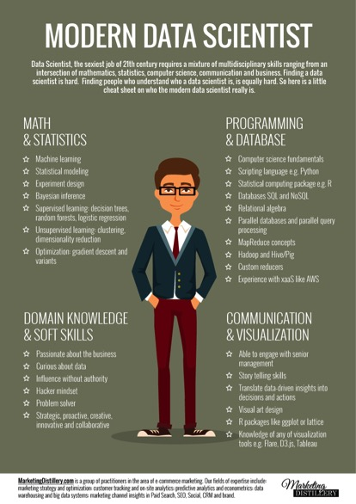
What does it take to be a good visualization professional? (III)

Slide 11
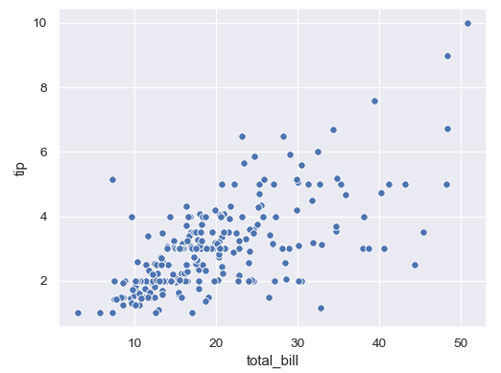
What does it take to be a good visualization professional? (III)
Questions we may ask about a visualization:
What type of chart is it?
What is the key message overall?
Is this the best possible way to convey the message?
Is it the most important insight from the underlying data?
How can we create it?
What type of data is required?
Is the data representative?
Is the message valid?

Slide 12
Coursework (I)
Structure of the class
All lectures will be synchronous
Will be on Mondays and Wednesdays at 04:30 pm - 05:50 pm .
Your attendance is required
All lectures will be recorded and available in Blackboard.
Do not hesitate to email me if you have any questions.
You may also contact our Course Assistant.

Slide 13
Coursework (II)
Assignments
Individual Projects: 1A, 1B, 1C
Individual/Team Projects: 2A, 2B, 2C (Maximum Group Size: 2)
Mid-term (10)
Participation (10)
No final exam.
1 | 2 | 3 | 4 | 5 | 6 | 7 | 8 | 9 | 10 | Points
1/9-1/15 | 1/16-1/22 | 1/23-1/29 | 1/30-2/5 | 2/6-2/12 | 2/13-2/19 | 2/20-2/26 | 2/27-3/5 | 3/6-3/12 | 3/13-3/19
 | 1A |  |  |  |  |  |  |  |  | 10
 |  | 1B |  |  |  |  |  |  |  | 10
 |  |  | 1C |  |  |  |  |  |  | 15
 |  |  |  | Mid- term |  |  |  |  |  | 10
 |  |  |  |  | 2A |  |  |  |  | 10
 |  |  |  |  |  |  | 2B |  |  | 10
 |  |  |  |  |  |  |  | Final |  | 25
Participation |  |  |  |  |  |  |  |  |  | 10

Slide 14
Course materials
This course will have no required textbook.
All slides and videos will be shared to Blackboard after the class.

Slide 15
Schedule 1 of 2 (subject to adjustments)
Week | Topic | Software | Homework
1 | Introduction and overview What is data/information visualization? Why do we need to visualize information?
2 | Taxonomies I Types of visualization Types of actions using visualization | RAW | Project 1A (10): Creating data visualization using RAW.
3 | Taxonomies II More types of visualization Types of data | Tableau | Project 1B (10): Creating and sharing visualization using Tableau.
4 | Grammar of Graphics What is in a visualization? |  | Project 1C (15): Reflection on your experience using RAW and Tableau based on Grammar of Graphics
5 | Introduction to R R and RStudio Data manipulation in R Basic plotting system of R | R | Mid-term (10): A take- home exam.

Slide 16
Schedule 2 of 2 (subject to adjustments)
Week | Topic | Software | Homework
6 | ggplot2 package of R Grammar of graphics Basics of ggplot2 | R/ggplot2 | Project 2A (10): Identify and understand a dataset using R to prepare a visualization work
7 | Cognitive models Cognitive science of visualization How to choose visual cues
8 | Interactive visualization Types of interactive visualization Static vs. interactive visualization | R | Project 2B (10): Implement your graph from Project B1
9 | Story-telling using visualization What is in a story How to translate stories into visualizations |  | Project 2C and Final project (20) Reflect, redesign, and share your final design.
10 | Unsolved problems Credibility of data visualization Visualizing uncertainties

Slide 17
Grading Scale
Grade | GPA | Range
A+ | 4.00 | 98.00 | 100.00
A | 4.00 | 93.00 | 97.99
A- | 3.67 | 90.00 | 92.99
B+ | 3.33 | 88.00 | 89.99
B | 3.00 | 82.00 | 87.99
B- | 2.67 | 80.00 | 81.99
C+ | 2.33 | 78.00 | 79.99
C | 2.00 | 72.00 | 77.99
C- | 1.67 | 70.00 | 71.99
D+ | 1.33 | 68.00 | 69.99
D | 1.00 | 60.00 | 67.99
F | 0.00 | 0.00 | 59.99

Slide 18
Course Policies
Late submission policy
All submissions must be made on Blackboard. You may request for an extension prior to the deadline by contacting the instructor with your reasons. Late submissions without an approved extension will receive 20% reduction per day.
Incomplete policy
At least 80% of the graded coursework must have already been completed in order for an incomplete grade to be considered (per the recommendation of the Provost’s Office). The student and the instructor should agree on a due date of completion so that it will be completed within the following 12 months. It can be found here: http://drexel.edu/provost/policies/incomplete_grades/.

Slide 19
Academic integrity, plagiarism and cheating policy
The official version of policies related to academic dishonesty can be found in the link below. It is your responsibility to read the policy carefully.
http://www.drexel.edu/provost/policies/academic_dishonesty.asp
http://www.drexel.edu/studentlife/judicial/honesty.html
Once it can be established that an academic dishonest act has been conducted in connection to any of the coursework in this class, a two-letter grade reduction will be applied to the overall course grade as a penalty. The identified incidence will be reported to the University. As the ultimate penalty, the University may withdraw a degree as a result of academic dishonesty.
Students with disability statement
http://www.drexel.edu/oed/disabilityResources/students/
Course drop policy
http://www.drexel.edu/provost/policies/course_drop.asp
http://www.drexel.edu/provost/policies/course_withdrawal_policy.asp
Course change policy
The content of the course is subject to change during the term at the discretion of the instruction. Details of change will be announced on Blackboard as soon as decisions of such change are made.
Intellectual property
http://www.drexel.edu/provost/policies/patent_policy.asp

